Slide 1

Spotify Data Analysis
Deepika Awasthi, Maria Lara, Tanner Lievois

Slide 2

Summary
How Artists Popularity is defined?
Genre
Audio Features
Artists Followers
Yearly releases
Song Trends
Findings

Slide 3
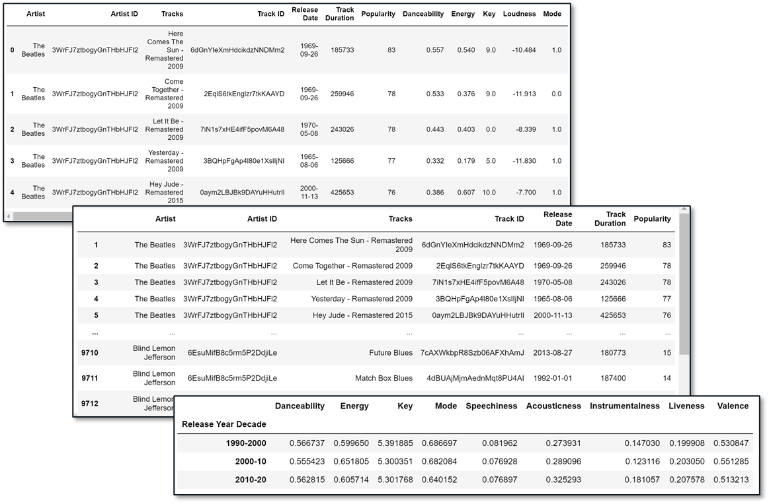
Data Clean up & Exploration
Spotify API
Top 1000 Artists
Top 10 Tracks
Dropping “NaN” values
Popularity & Decade bins
Filter/Sort
CSV files

Slide 4
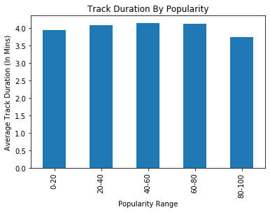
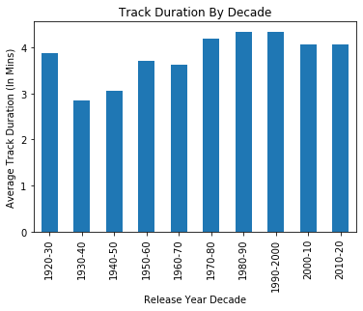
Track Duration Analysis

Slide 5
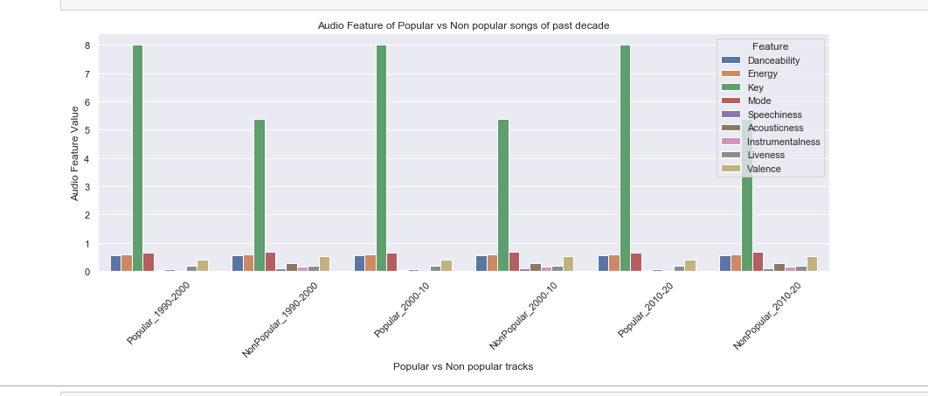
Audio feature Analysis

Slide 6
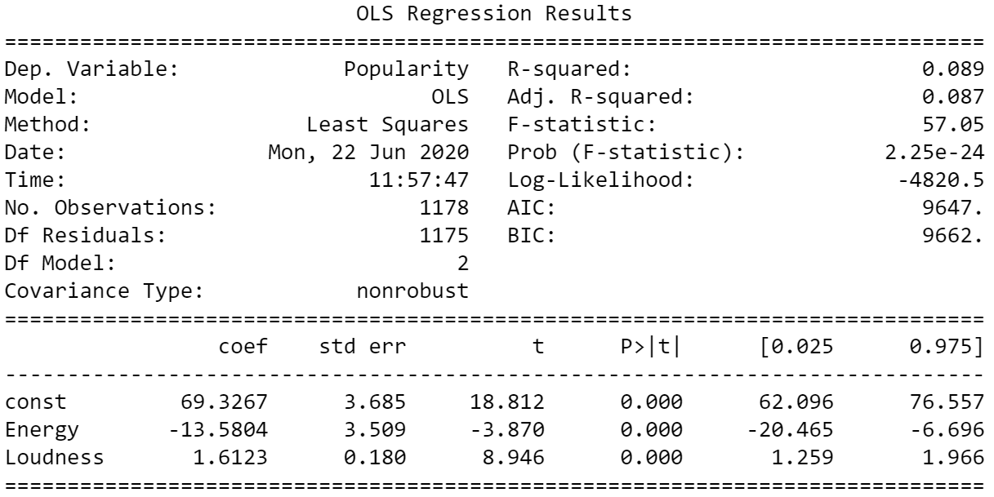
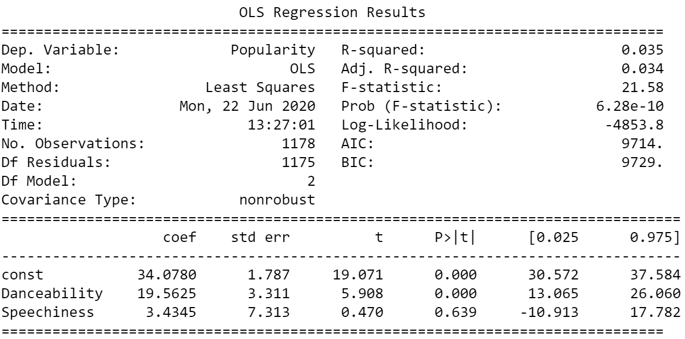
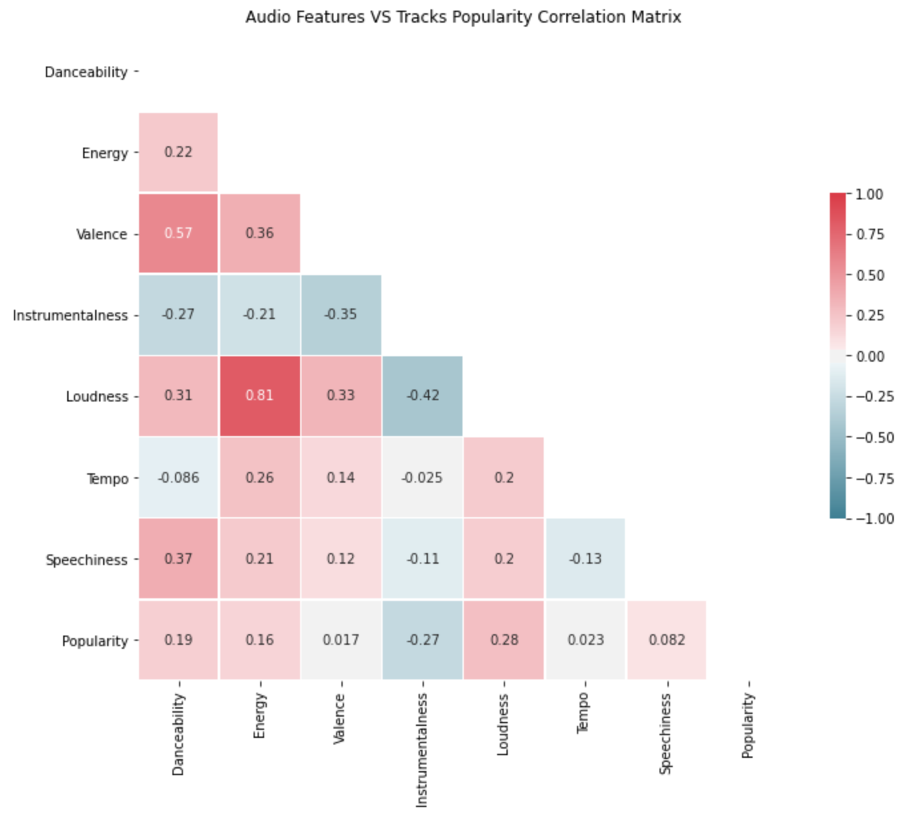
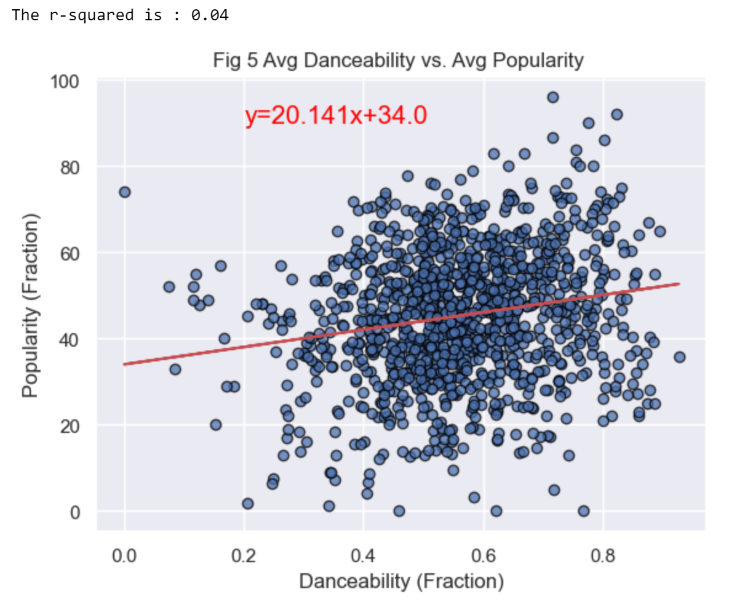
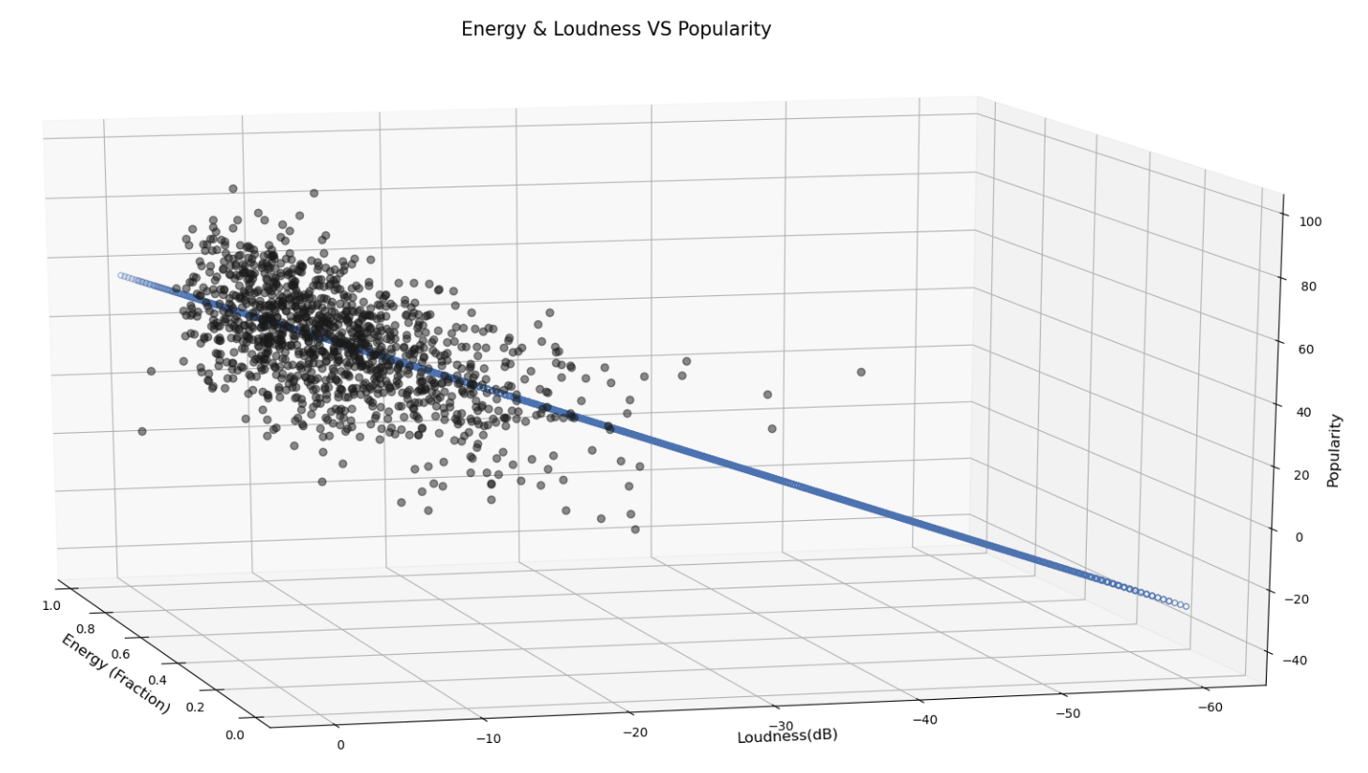
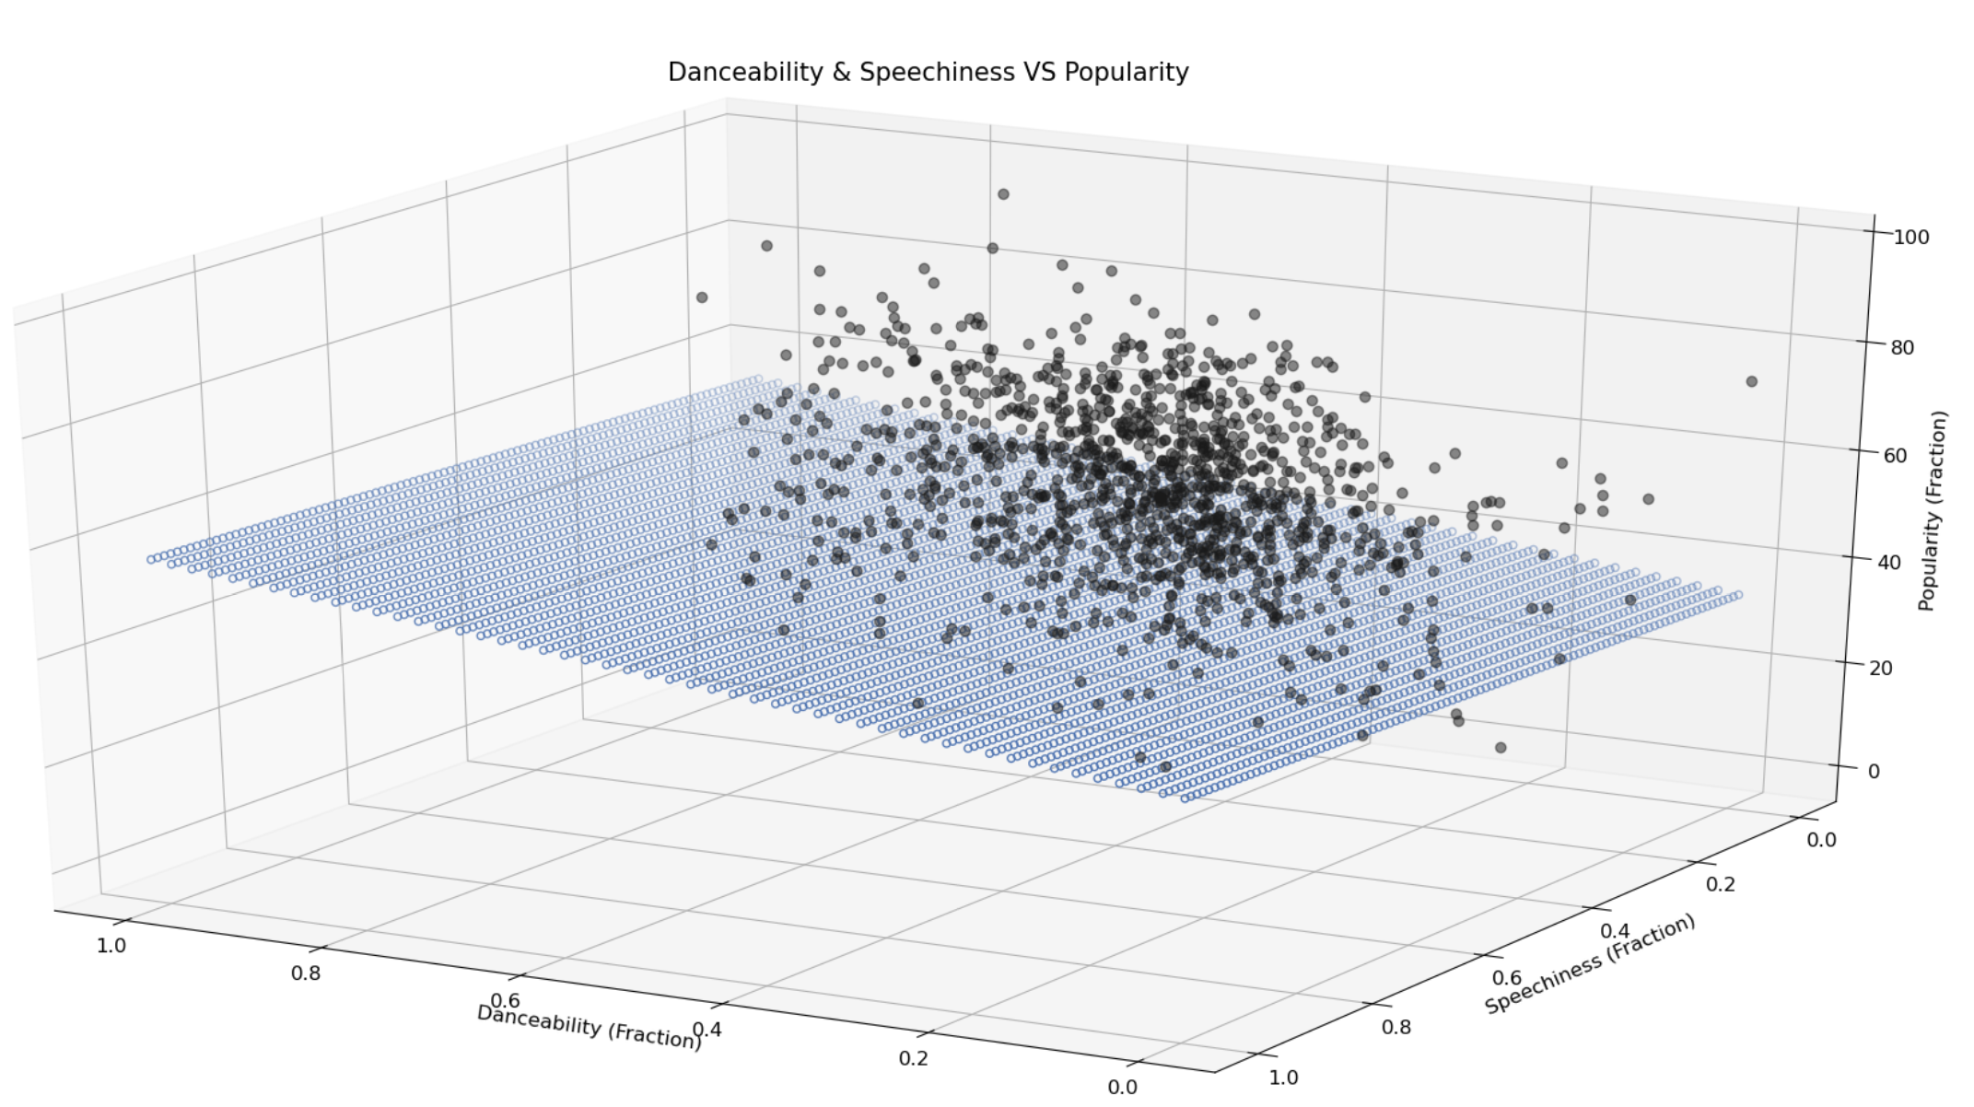
Does Tracks Features affect songs popularity?

Slide 7
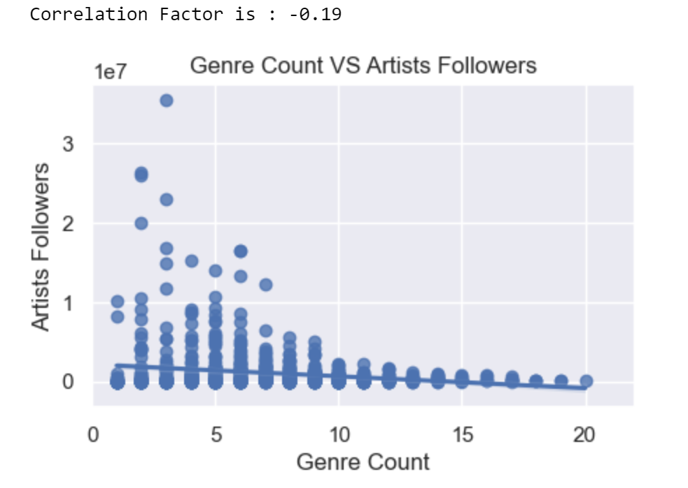
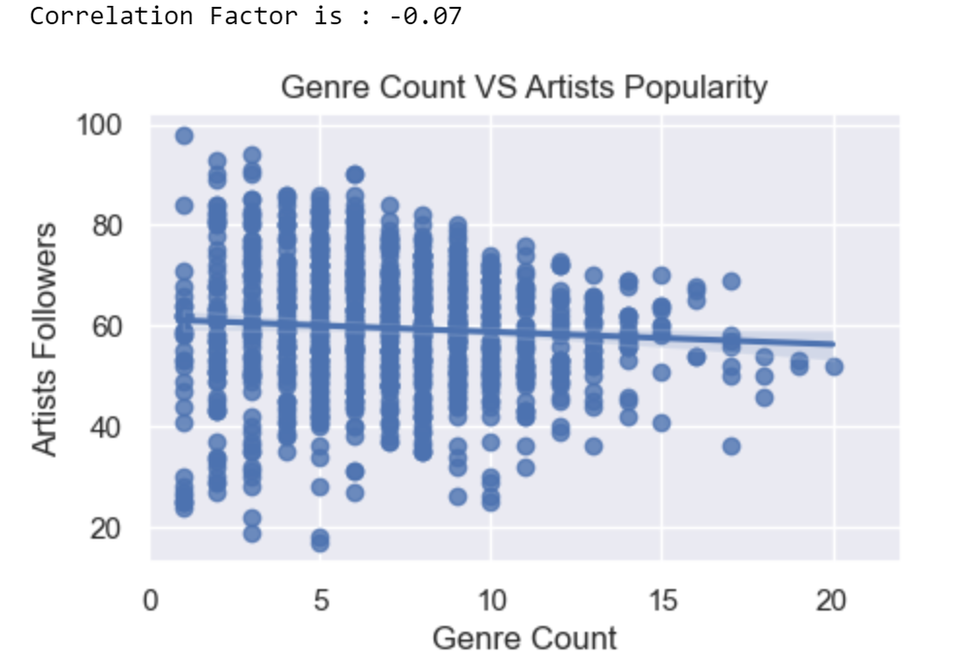
Are diverse artists more popular?

Slide 8
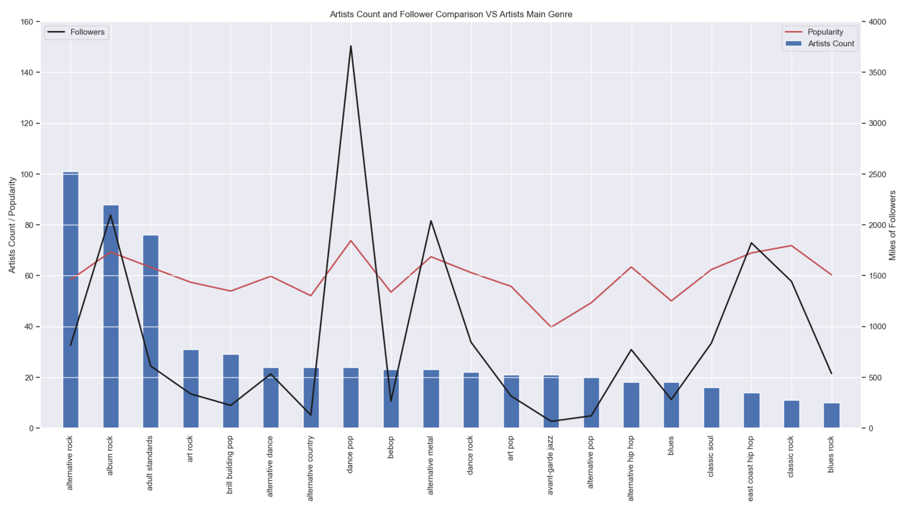
Genre makes an artist popular and most followed?

Slide 9
Discussion
Conclusions –
Narrow scale show clear trends
No Universal Rule for popularity
Genre Diversity not related to popularity
New Questions –
Genre definition
Predict future trends

Slide 10
Post Mortem
Genre Popularity
Different locations
Compare with another API
Sampling and T-Test

Slide 11

Questions?

